Slide 1

Investing
Jeriel Wong
Trading

Slide 2
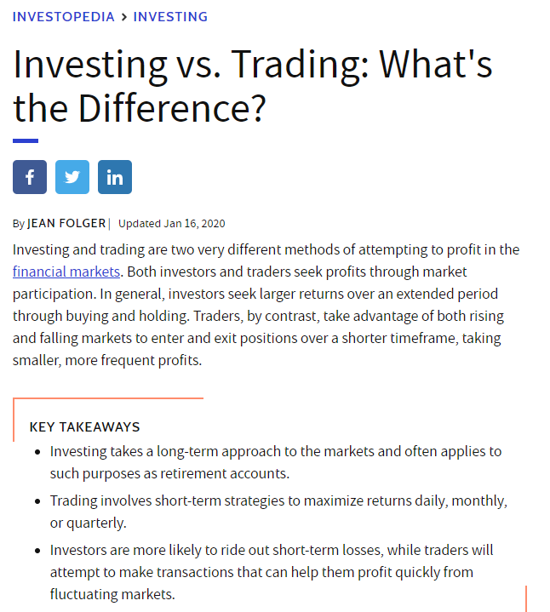
A Non-Business Orientated
Problem Statement
-------------------------------------------------------
Investopedia
The words Investing and Trading are used interchangeably, and loosely, in the world.
Friend A : I am going to invest in this stock/company
Friend B : I am going to trade this stock/company
So is there actually a distinction ?
Users of reddit should proceed to which subreddit Investing or Trading ?
1.20 million members in Investing , created on 15 March 2008
0.03 million members in Trading , created on 21 August 2008
Head start >>>> Herd Mentality ?
Notes:
A non-business orientated statement ☺

Slide 3
CONTENT OVERVIEW
Modern and Minimal Presentation Template
Data Refining
Exploratory Data Analysis
Modelling

Slide 4
Data Refining
------------------------------------------------------------------
Import
Combine
Classify
Drop Duplicates
Title + Self Text
Investing = 0
Concatenate
Clean Post
Trading = 1
Reset Index
Stemming
Stopwords

Slide 5
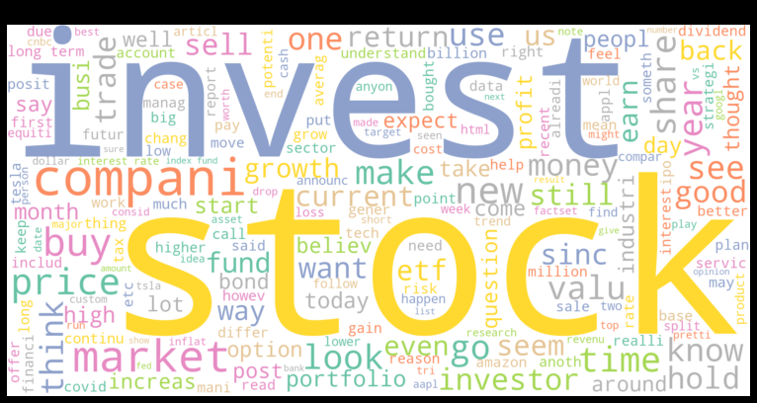
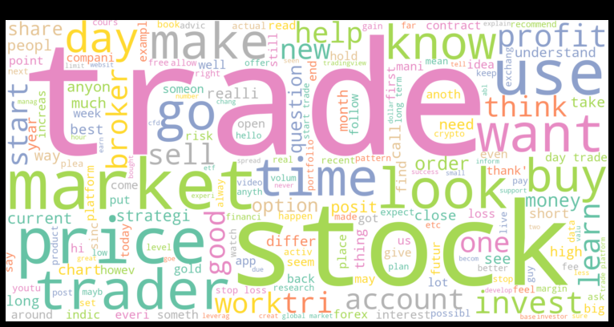
Exploratory Data Analysis
------------------------------------------------------------------------------------------------------------------------------------
Word Cloud
Word Cloud is a data visualization technique used for representing text data in which the size of each word indicates its frequency or importance.
Word Cloud

Slide 6
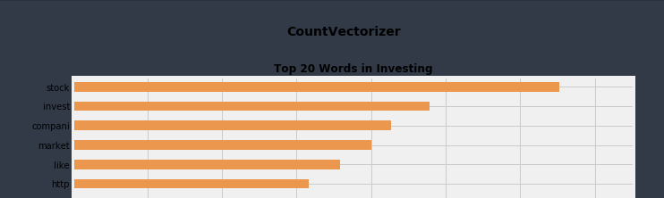
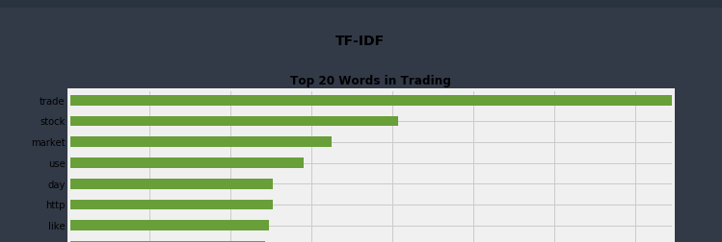
Bar Plots
Using TF-IDF and Count Vectorizer to find the top 20 word counts
http , com , www seems to be present in both subreddit even after applying clean post function, which includes beautiful soup
Bar Plots

Slide 7
Post EDA Adjustments
-----------------------------------------------------------------------------------------------------------------------
Removal of more stopwords
Common words and redundant words
price, know , money, http, www, com , invest, trade

Slide 8
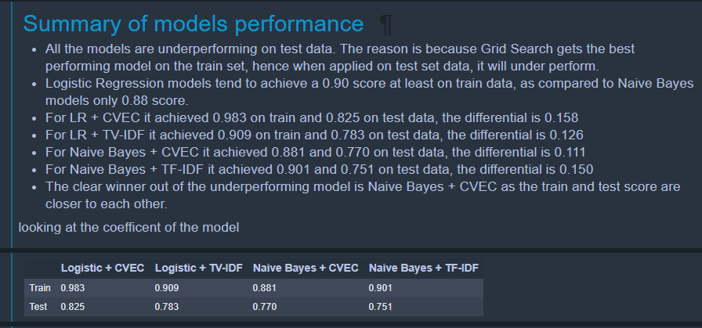
Modelling
Logistic Regression
Naïve Bayes
------------------------------------------------------------------
Logistic + CVEC
Naïve Bayes + CVEC
Logistic + TV-IDF
Naïve Bayes + TV-IDF

Slide 9
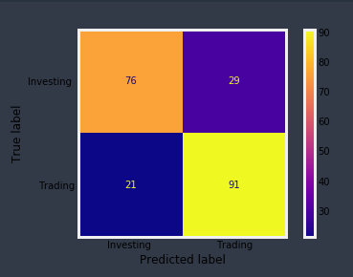
Accuracy: 0.77 Misclassification Rate: 0.23 Sensitivity: 0.812 Specificity: 0.724 Precision: 0.758
Accuracy: 0.77 Misclassification Rate: 0.23 Sensitivity: 0.812 Specificity: 0.724 Precision: 0.758
Modelling - Evaluation
------------------------------------------------------------------
Accuracy: 0.77
Misclassification Rate: 0.23
Sensitivity: 0.812
Specificity: 0.724
Precision: 0.758
Notes:
Performance Parameters
Negative = investing = 0
Positive = not investing / trading = 1
True positive = 91 posts that is trading, and predicted as trading
True negative = 76 posts that is investing , and predicted as investing
False positive = 29 posts that is investing , predicted as trading
False negative = 21 posts that is trading, predicted as investing
Type I error = False Positive = 29 posts
Type II error = False Negative = 21 posts
Type I or Type II error - which is worse ?
As a post is being misclassfieid as investing instead of trading, or vice versa, it does not have a 'worse-off' in being in either Type I or Type II, hence unable to explain which error is worse.
Performance Metrics
Accuracy of 0.77 = The model predicted 77% of test data correct to its respective Investing and Trading subreddit, as accuracy calculates the True Positive posts which is trading and the True Negative posts which are Investing.
Misclassification rate of 0.23 = 23% of the posts were classified, i.e. supposedly Investing subreddit, went to Trading subreddit, vice versa. This is also calculated as 100 % - ( accurac of 77% , which will gives 23%
Sensitivity of 0.81 aka True Positive Rate aka Recall = True Positives divided by Positives, i.e. the classified correctly Trading posts divided by ( trading posts that were predicted correctly and belong to trading posts + investing posts that were predicted as trading )
Specificity of 0.724 aka True Negative Rate = True Negatives divided by All Negatives, i.e. posts that were predicted as Investing and belong to Investing subreddit, divided by all investing posts, including those that were trading but predicted as investing posts.
Precision of 0.758 aka Positive Predictive Value = True Positives / ( True Positive + False Positives ) = Posts that are trading predicted as trading / all trading posts
ROC AUC score is 0.823, which means my 0 and 1 populations are close to perfect separation/distinction, a score 1 is the best, i.e. the Naive Bayes model is able to predict perfectly where the post should be in which subreddit.

Slide 10
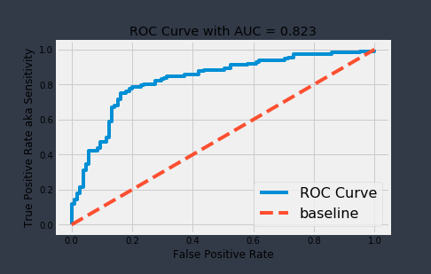
Accuracy: 0.77 Misclassification Rate: 0.23 Sensitivity: 0.812 Specificity: 0.724 Precision: 0.758
Accuracy: 0.77 Misclassification Rate: 0.23 Sensitivity: 0.812 Specificity: 0.724 Precision: 0.758
Modelling - Evaluation
------------------------------------------------------------------
ROC AUC = 0.823
Notes:
It tells how much model is capable of distinguishing between classes., a score 1 is the best, i.e. the Naive Bayes model is able to predict perfectly where the post should be in which subreddit., i.e.
With a score of 0.823, it means there 82.3% chance that the model can distinguish between positive and negative class
The bend in the curve is due to misclassification of FN and FP , if the model was a perfect TN and TP prediction, the curve would be 90 degress at the coordinates (0,1)
Hence this icurve bend is due to the introduction of FN and FP , commonly known as type I , type II error
Negative = investing = 0
Positive = not investing / trading = 1
True positive = 91 posts that is trading, and predicted as trading
True negative = 76 posts that is investing , and predicted as investing
False positive = 29 posts that is investing , predicted as trading
False negative = 21 posts that is trading, predicted as investing
Type I error = False Positive = 29 posts
Type II error = False Negative = 21 posts

Slide 11
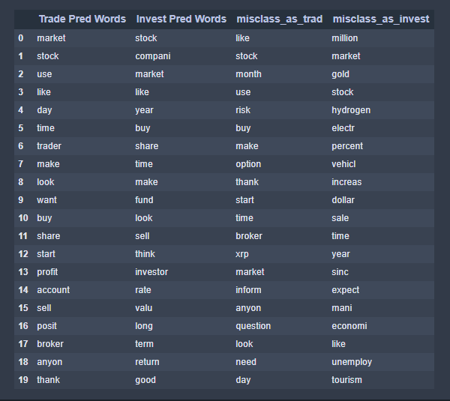
Accuracy: 0.77 Misclassification Rate: 0.23 Sensitivity: 0.812 Specificity: 0.724 Precision: 0.758
Accuracy: 0.77 Misclassification Rate: 0.23 Sensitivity: 0.812 Specificity: 0.724 Precision: 0.758
Modelling - Evaluation
------------------------------------------------------------------
Predictive Keywords – Word Level Analysis
Pred Words are derived from the coefficients of Naïve Bayes model
Misclass Words are derived from the using CountVectorizer on the Misclassified posts

Slide 12
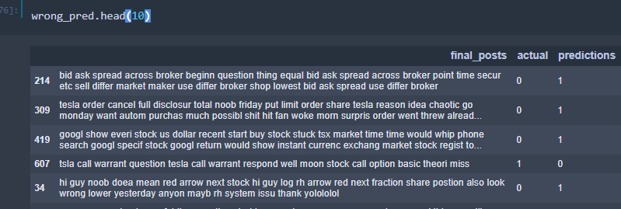
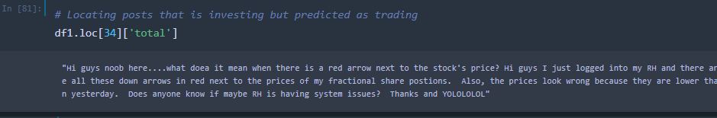
Accuracy: 0.77 Misclassification Rate: 0.23 Sensitivity: 0.812 Specificity: 0.724 Precision: 0.758
Accuracy: 0.77 Misclassification Rate: 0.23 Sensitivity: 0.812 Specificity: 0.724 Precision: 0.758
Modelling - Evaluation
------------------------------------------------------------------
Posts Level Analysis
Notes:
From this post, we can noticed the words: share, thank, anyon. are present in this Investing Subreddit post.
These words are the predicative words for a Trading subreddit
Based on this post context, the author is asking question about his stock platform (RH/ Robinhood) in the investing subreddit, and nothing relating much to investing-related.
Based on our model, NB , authors in investing subreddit are mostly posting about compani/companies, return, fund.
In such a case, it is deterministic that the author has posted in the wrong subreddit, i.e posted in Investing, but should be in Trading, therefore our model is actually working well, the misclassification is due to human error.

Slide 13
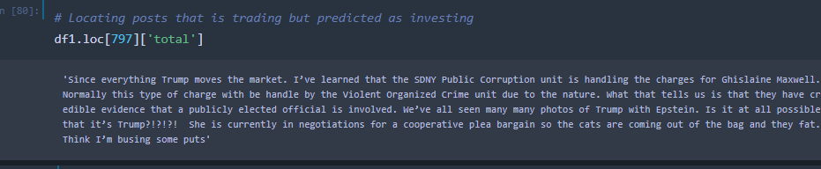
Accuracy: 0.77 Misclassification Rate: 0.23 Sensitivity: 0.812 Specificity: 0.724 Precision: 0.758
Accuracy: 0.77 Misclassification Rate: 0.23 Sensitivity: 0.812 Specificity: 0.724 Precision: 0.758
Modelling - Evaluation
------------------------------------------------------------------
Posts Level Analysis
Notes:
The author of ths post is sharing his thoughts about the market, on how Trump aggressive actions might lead to the market price going down.
In this posts, we dont really see any predicative words of investing, reason because we only look at the top 20 coefficients of the Naive Bayes model, hence we might not get a clear picture.
For this post we cannot determine whether the author posting trading or investing is correct, or whether the model is predicting wrongly or correctly.

Slide 14
Accuracy: 0.77 Misclassification Rate: 0.23 Sensitivity: 0.812 Specificity: 0.724 Precision: 0.758
Accuracy: 0.77 Misclassification Rate: 0.23 Sensitivity: 0.812 Specificity: 0.724 Precision: 0.758
Modelling - Evaluation
------------------------------------------------------------------
Posts Level Analysis
Notes:
The author of ths post is sharing his thoughts about the market, on how Trump aggressive actions might lead to the market price going down.
In this posts, we dont really see any predicative words of investing, reason because we only look at the top 20 coefficients of the Naive Bayes model, hence we might not get a clear picture.
For this post we cannot determine whether the author posting trading or investing is correct, or whether the model is predicting wrongly or correctly.

Slide 15
Conclusion
-----------------------------------------------------------------------------------------------------------------------
Recommendation
Limitations
Redefining Description
Subreddit Merger
Auto Subreddit Classifier
Common Predictive Words
Sample Size
Coefficients > 20
Notes:
Redefining Description
#1 : Moderators can re-define the description of each subreddit, so that posters have a sense of which subreddit to enter, this would improve user experience and readers/authors know the differences of the two subreddits.
Subreddit Merger
#2 : Although I might not have included the common predictive words for both subreddits, it also suggests another point of view, if there is so much similarity, could the two subreddit be combined as 1 subreddit ? Investing subreddit has 1.20 million members, Trading has 0.03 million members
Auto Subreddit Classifier
#3 With this model, it is able to identify 77% of the posts accurately, reddit could deploy this model to 'force' authors to select the proper subreddit, i.e. after the author types his/her post, if the models predicts it belongs to Investing, authors have no other options but to post to Investing
Limitation(s):
#1 : Common Predictive Words
Predictive words that are present in predicting it is a Trading or Investing subreddit, could have been further included in the stopwords. This would allow better features being selected, which could lead to a better prediction model.
#2 : Sample Size
The train dataset studied on 868 posts , whilst the test dataset only has 217. The test sample size might be too small, and some of these posts could be mostly hyperlink sharing, which does not tell much about the post.
#3 : Coefficients 20
As the coefficients captured are only the top 20, some posts could not be understood as the posts might be only having the coefficients of rank 40 or rank 50 onwards.

